Slide 1
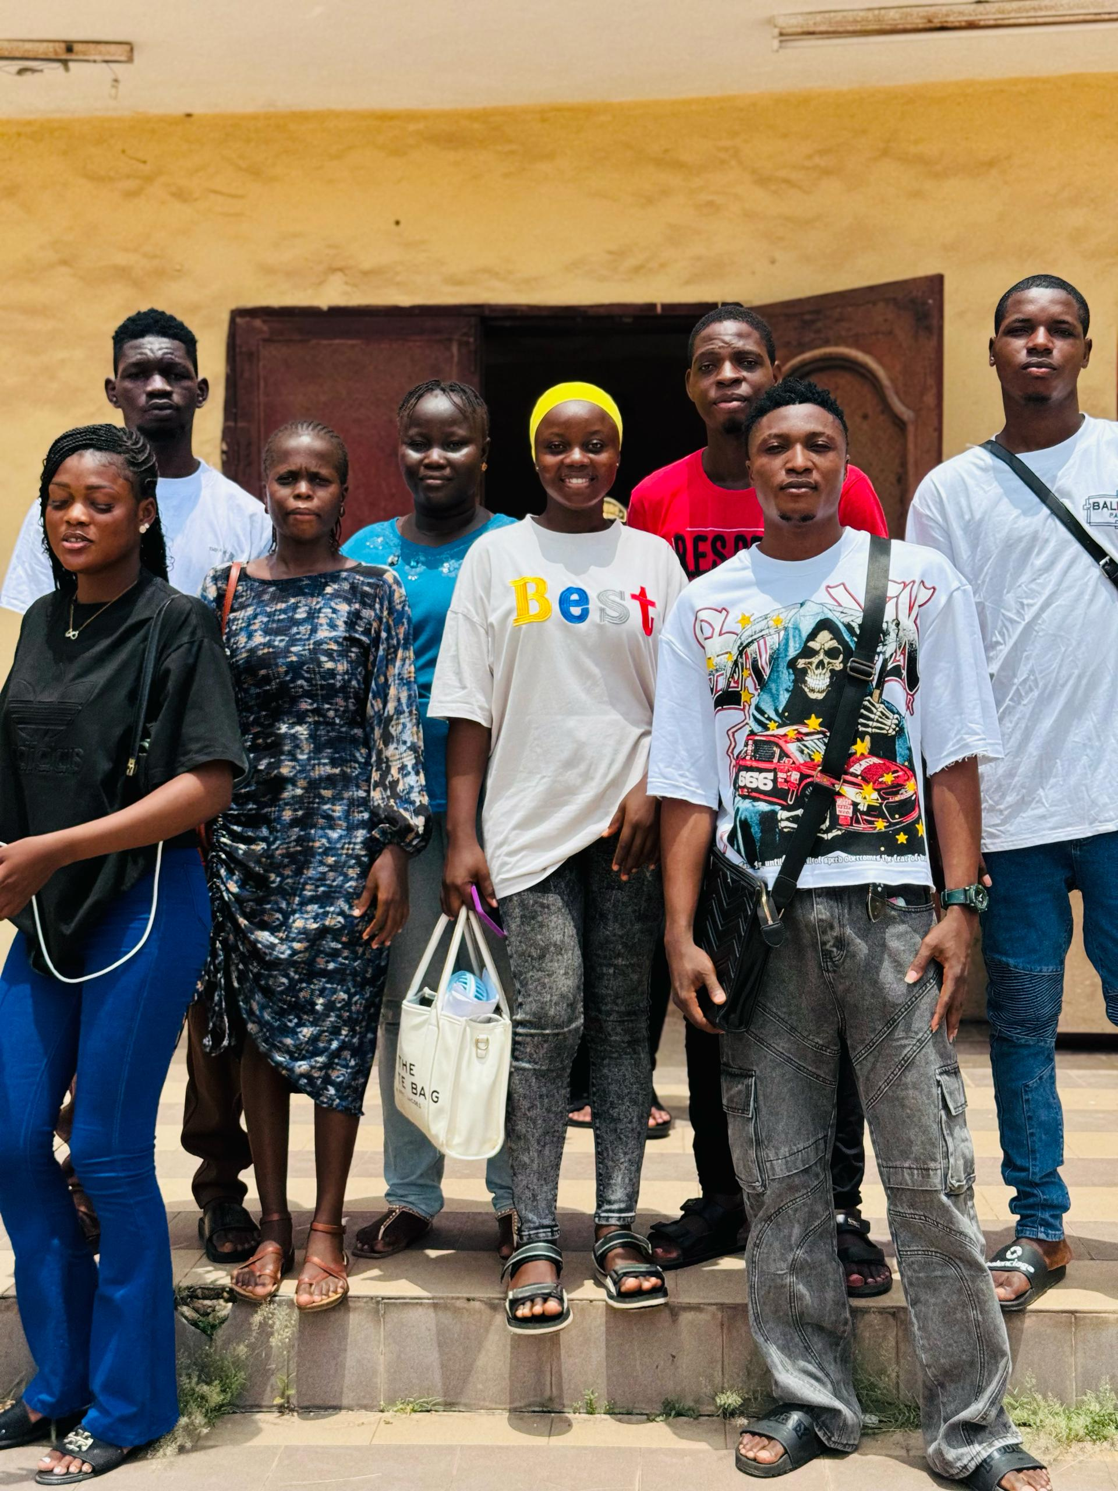
Departmental WALK TOUR PROJECT
COM 415

Slide 2
NAME OF MEMBERS
1. DAVIES OLUWABUKOLA 20/69/0043
2. OGUNTADE OYINKANSOLA 20/69/0048
3. BILLYGBETI CHINOSO 19/69/0148
4. AFOLABI ABAYOMI 19/69/0053
5. AFOLABI ODUNAYO SAMUEL 23/305/01/F/0051
6. ASHIMI HIKIMOT OMOWUNMI 23/305/01/F/0113
7. AVONO JAMES 23/305/01/F/0050
8. ONAKOYA GIDEON 20/85/0092
9. ASOGBON SAMUEL 20/85/0048
10. IDOWU DAVID JUWON 23/305/01/F/0138
11. MAKANJUOLA BOLUWATIFE BALIKIS 19/69/0274
12. BASSEY HONESTY 19/69/0055
14. JOHNSON OLUWADAMILOLA 19/69/0160
15. ALIU JAMIU ABIODUN ` 19/69/0309
16. BELLO BOLUWATIFE 20/69/0024
17. AWOSELU ENIOLA OLOLADE 23/305/01/0004
18. AJAYI DEBORAH TITILAYO 20/69/0049
19. ONAFESO TEMITAYO FREDRICK 23/305/01/F/0033

Slide 3
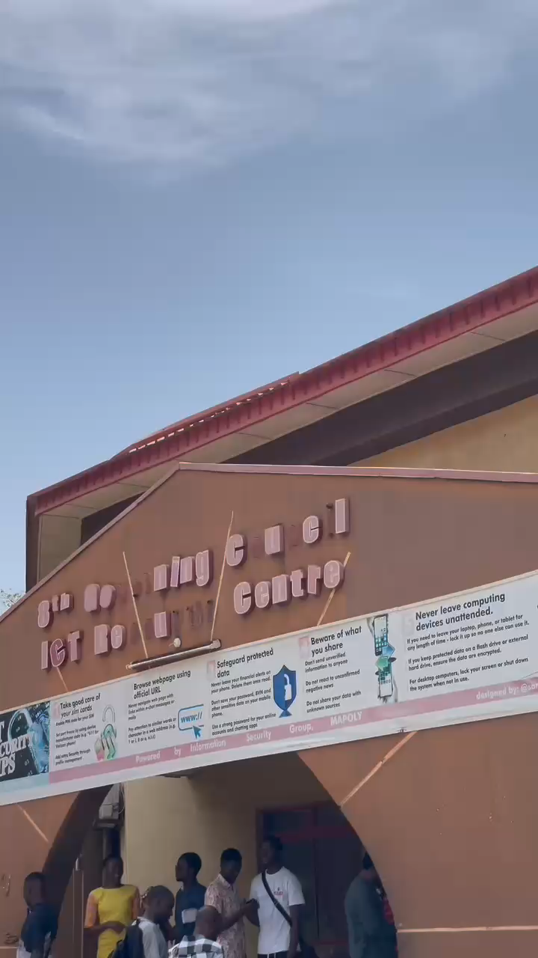
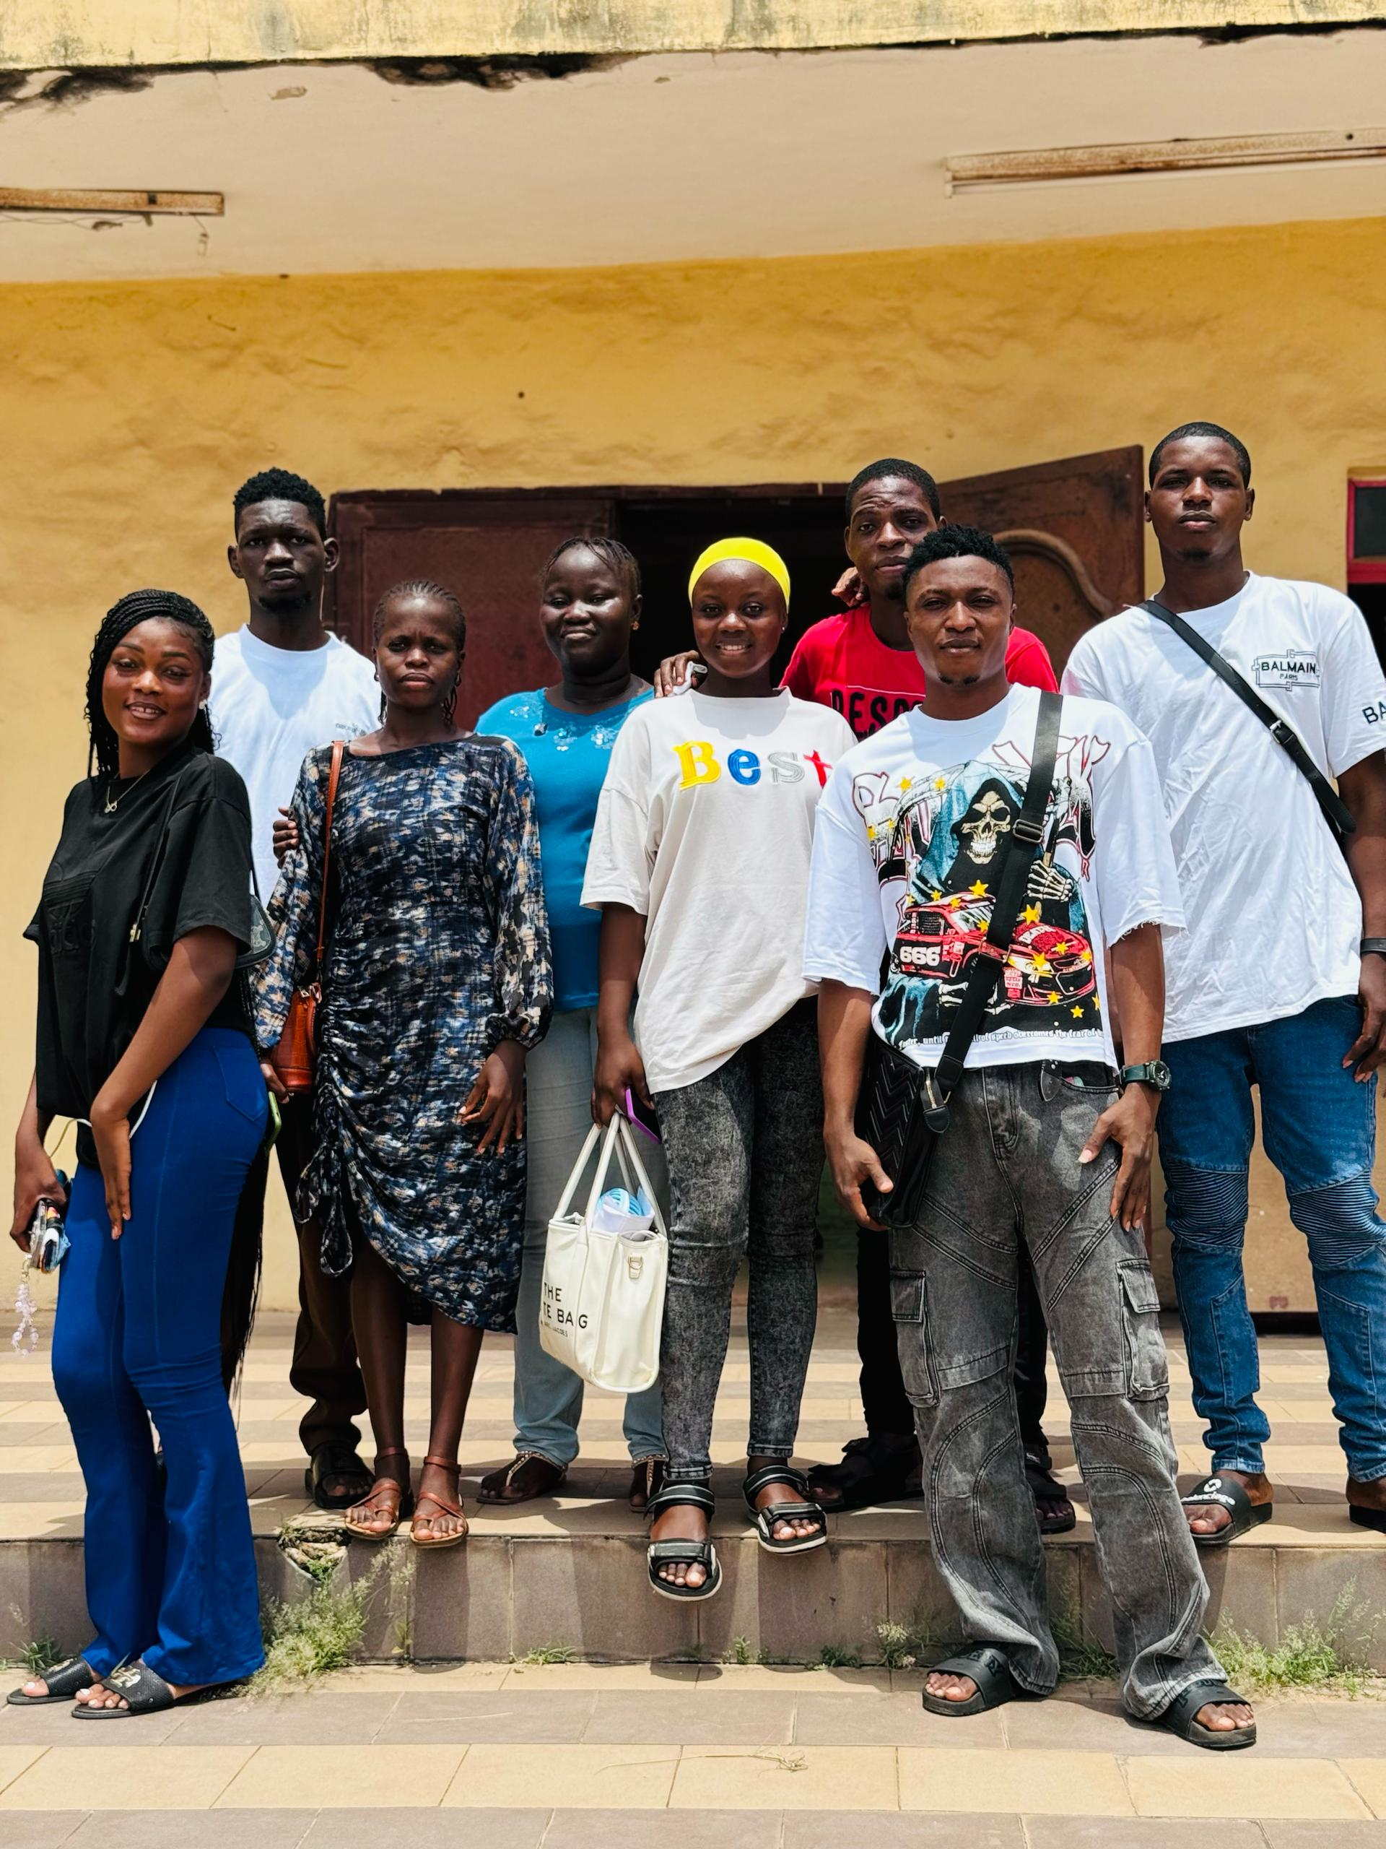
Computer Science Department Walk Tour:
Welcome to the Computer Science Department! We're excited to show you around and introduce you to our team.
A department walk tour can:
1: Department- Meet our department head, who will provide an overview of the department's mission, goals, and research areas.- Learn about our undergraduate and graduate programs, including our research focus areas.
2. Faculty Offices - Meet some of our faculty members, who will share their research interests and areas of expertise.- Learn about our faculty's industry experience and collaborations.

Slide 4
Welcome to the Computer Engineering Department!
Welcome to the Computer Engineering lecturers office!
1: Research Labs (20 minutes)- Visit our state-of-the-art research labs, where you'll see students and faculty working on cutting-edge projects.- Explore our specialized labs, including: - Artificial Intelligence and Machine Learning Lab
- Cybersecurity Lab
- Internet of Things (IoT) Lab
- Robotics Lab
2: Teaching Labs - Visit our teaching labs, where students learn hands-on skills in computer engineering

Slide 5
LIBRARY WALK TOUR
1: Library Entrance and Information Desk - Start at the library entrance, where you'll find our information desk.- Meet our friendly library staff, who can answer any questions you may have.
2. Circulation and Book Collections
3. See our research and study areas, where you can access computers, printers, and scanners.
4. Collaborative Workspaces and Group Study Rooms
Welcome to our library! We're excited to show you around and introduce you to the various resources and services we offer.

Slide 6
Purpose:
1. Inspire learning: Motivate students to explore the department's offerings, sparking interest in computer science or computer engineering fields.
2. Promote collaboration: By introducing team members from different departments and encouraging communication.
3. Enhance understanding: Of the organization's operations, processes, and services.
The primary purpose of a department walk tour is to:

Slide 7
BENEFITS OF DepartmenT Walk Tour
Overall Benefits:
1. Enhanced understanding: Visitors gain a deeper appreciation for the department's work and its contributions to the field.
2. Networking opportunities: Visitors can connect with faculty, students, and peers, potentially leading to future collaborations or opportunities.
3. Increased engagement: The tour can inspire students to participate in departmental activities, research projects, or student organizations.

Slide 8
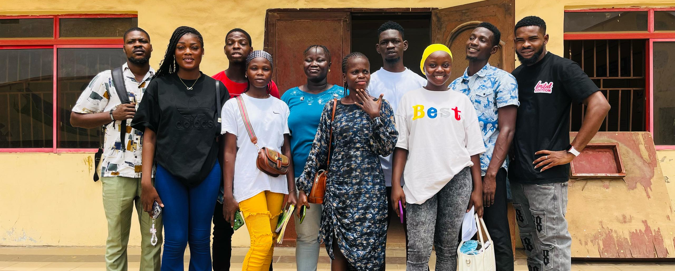
CONCLUSION OF THE DEPARTMENT WALK TOUR
Thank you for joining us on this department walk tour. We hope you found it informative and helpful in understanding of our department's research, teaching, and student activities.

